Slide 1
Overview Of Splunk By Group -2

Slide 2
Content:
What is Splunk ?
Need Of Splunk
Features of Splunk
How Splunk Works
Splunk Products
Splunk Architecture
Advantages of Splunk
Disadvantages of Splunk
Alternative to Splunk

Slide 3
What is Splunk ?
Splunk is a software platform widely used for monitoring, searching, analyzing and visualizing the machine-generated data in real time.
Splunk is an innovative technology which searches and indexes log files and helps organizations derive insights from the data.
A main benefit of Splunk is that it uses indexes to store data, and so does not require a separate database to store its information.

Slide 4
Why we Need Splunk?
Splunk is a Enterprise Logging tool, which has a very great community to support user documentation.
Apart from that it also has Enterprise security component where you can control the Role based access control.
Analytics is also good when compared to other Logging tools.
It also has Hybrid options like On-Prem, Cloud storage or Both.

Slide 5
Features of Splunk:
Important features of Splunk are:
Accelerate Development & Testing
Allows you to build Real-time Data Applications
Generate ROI faster
Agile statistics and reporting with Real-time architecture
Offers search, analysis and visualization capabilities to empower users of all types

Slide 6

How Splunk Works?
Forwarder
Indexer
Search Head

Slide 7
Splunk Products:
Splunk is available in three different versions.
Splunk Enterprise
Splunk Light
Splunk Cloud

Slide 8
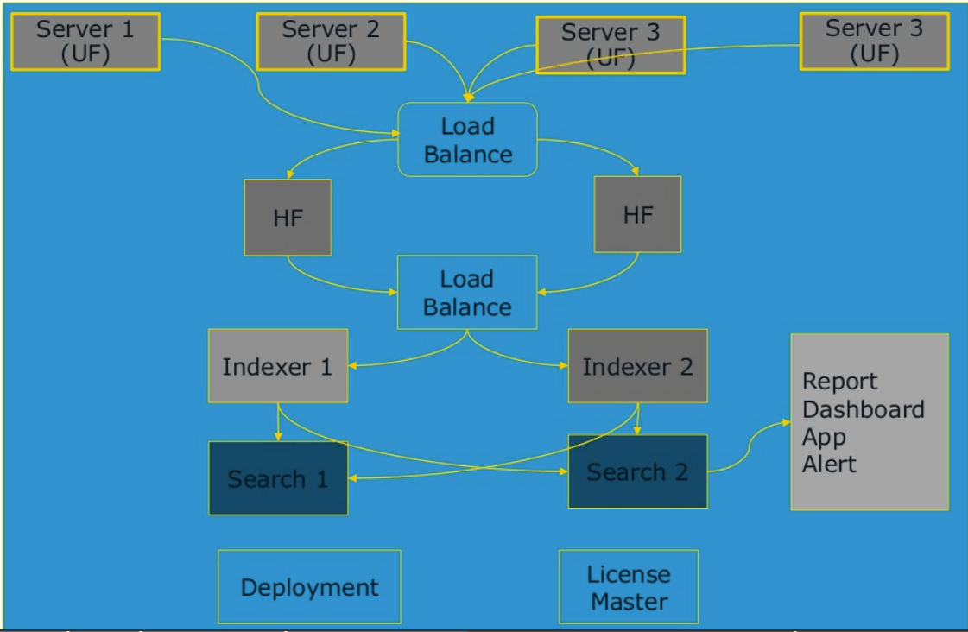
Splunk Architecture

Slide 9
fundamental components of Splunk architecture:
Universal Forward (UF)
Load Balancer (LB)
Heavy forward (HF)
Indexer (LB)
Search head (SH)
Deployment Server(DS)
License manager (LM)

Slide 10
Advantages:
It reduces troubleshooting and resolving time by offering instant results.
Splunk allows you to generate graphs, alerts, and dashboards.
You can easily search and investigate specific results using Splunk.
Splunk allows you to accept any data type like .csv, json, log formats, etc.

Slide 11
Disadvantages:
Splunk can prove expensive for large data volumes.
Searches are difficult to understand, especially regular expressions and search syntax.
Dashboards are functional but not as effective as some other monitoring tools.
Its learning curve is stiff, and you need Splunk training as it’s a multi-tier architecture. So you need to spend lots of time to learn this tool.

Slide 12
Alternative to Splunk
Sumo Logic
Loggly
Fluentd
ELK stack
LogFaces

Slide 13
Thank You

